Slide 1
3. Complementary MOS
Fondamenti di Elettronica
Sergio Spanò – spano@ing.uniroma2.it

Slide 2
Electric considerations: Binary values
The ‘1’ and ‘0’ values are usually referred to voltage values
Example 5 V for 1 and 0V for 0
3.3 V for 1 and 0 V for 0
1.1 V for 1 and 0V for 0
It is very important to reduce the Voltage used for the 1 because there is a relation between the power supply of digital circuits and its power consumption.
To reduce power consumption is very important especially for mobile devices that are powered by battery
A lower power consumption implies a longer battery life.

Slide 3
Electric considerations: Logic families
Digital circuits are implemented using logic gates
A logic gate is a circuit composed by electronic devices
Some Logic families can be classified broadly according to the technology they are built with:
DL: Diode Logic.
RTL: Resistor Transistor Logic.
DTL: Diode Transistor Logic.
HTL: High threshold Logic.
TTL: Transistor Transistor Logic.
I2L: Integrated Injection Logic.
ECL: Emitter coupled logic.
MOS: Metal Oxide Semiconductor Logic (PMOS and NMOS).
CMOS: Complementary Metal Oxide Semiconductor Logic

Slide 4
Electric considerations: CMOS family
Among these families the most used is the CMOS:
CMOS technology imply easy integration.
Easy design.
Low power consumption
CMOS: Complementary MOS
p and n type MOS are both used to build a logic gate
The knowledge of MOSFETs is required

Slide 5
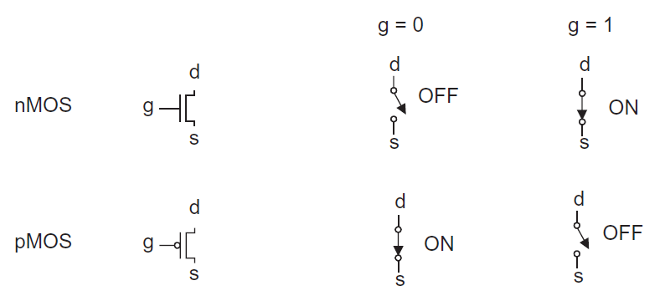
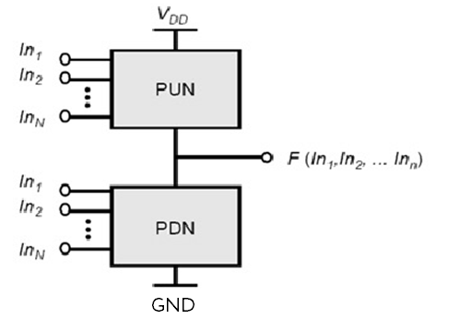
Mosfet as switch
In digital circuits, MOSFETs work only in saturation or interdiction and can be assumed to be switches
The “upper part” of any CMOS is made by pMOS and it is connected to the power supply (Vdd or Vcc)
PULL UP Network
The “lower part” of any CMOS is made by nMOS and it is connected to the ground (GND)
PULL DOWN Network

Slide 6
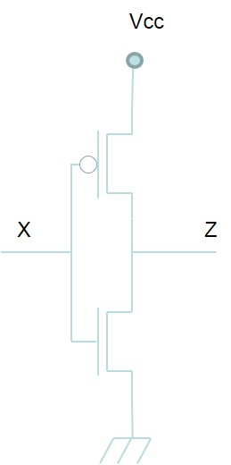
CMOS gates: Inverter 1/3
Assuming 1=Vcc and 0=0 V
Gates are connected to the input
Drains are connected to the output
P-MOS source is connected to the power supply
N-MOS source is connected to the ground

Slide 7
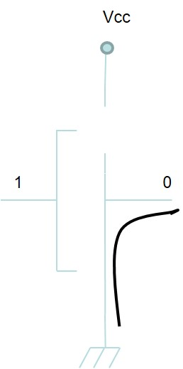
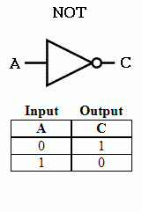
CMOS gates: Inverter 2/3
When input is ‘1’ =Vcc N-MOS is ‘on’ and P-MOS is ‘off’
Output is connected to ground and is ‘0’

Slide 8
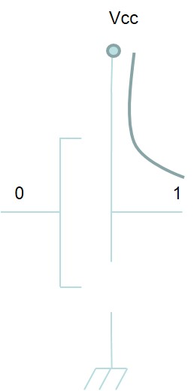
CMOS gates: Inverter 3/3
When input is ‘0’ =ground N-MOS is ‘off’ and P-MOS is ‘on’
Output is connected to Vcc and is ‘1’

Slide 9
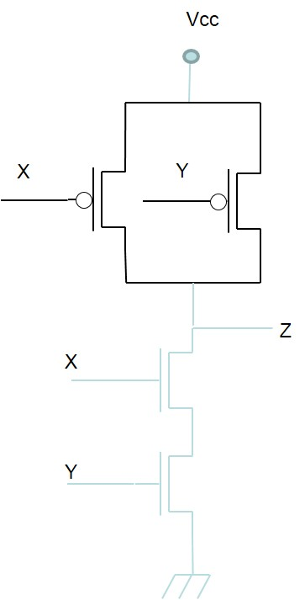
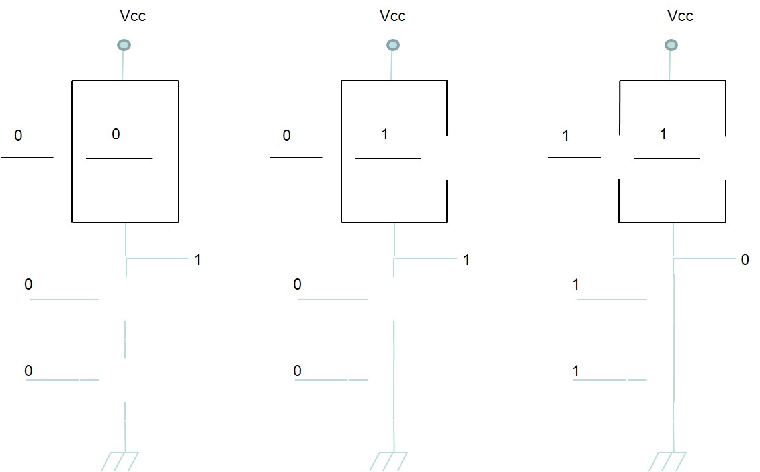
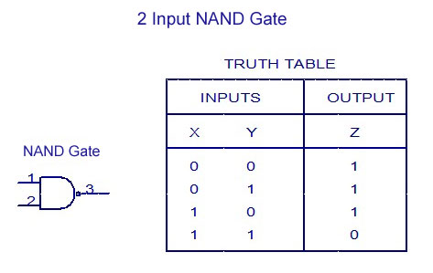
CMOS gates: NAND

Slide 10
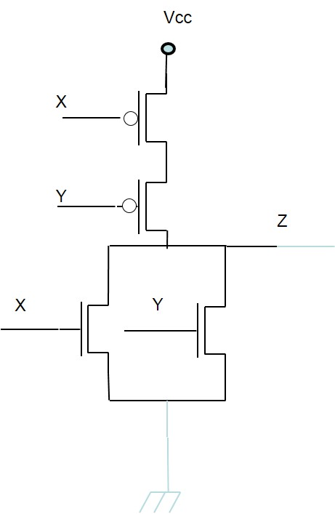
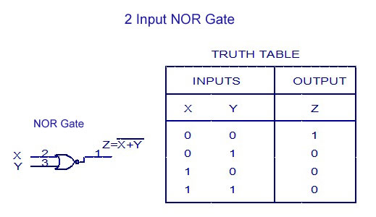
CMOS gates: NOR

Slide 11
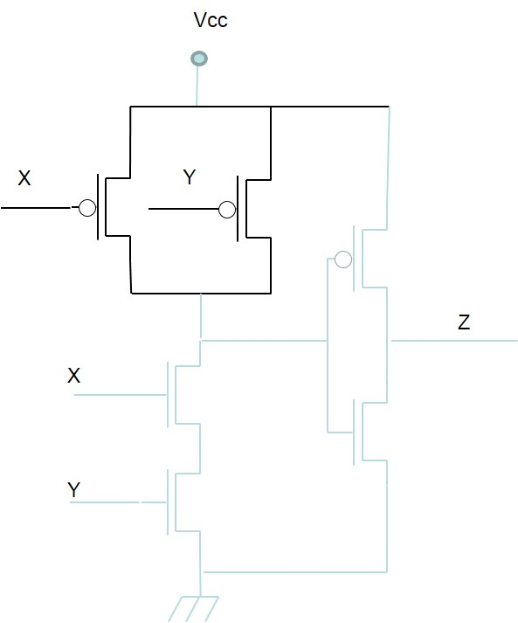
CMOS gates: AND
Not negated circuits can be obtained inserting an inverter at the output
QUESTION
How an OR gate is made in CMOS?
NAND
NOT

Slide 12
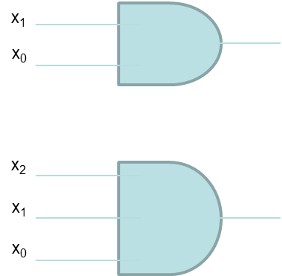
Fan-in
The fan-in is the number of inputs of a logic gate
Fan-in: 2
Fan-in: 3

Slide 13
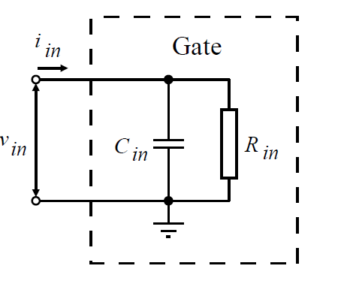
Propagation time 1/2
A CMOS gate (not, and or etc etc) input has a not trascurable Capacitance.
Capacitance is due to the coupling of metal-oxide –semiconductor on the gate
Capacitance implies that the output will not change instantaneously when the input changes

Slide 14
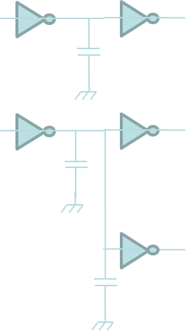
Propagation time 2/2
The Capacitance increases with the number of gates connected to the output.
The ‘load’ of gate input is measured with integer numbers and is called LOAD FACTOR (L)

Slide 15
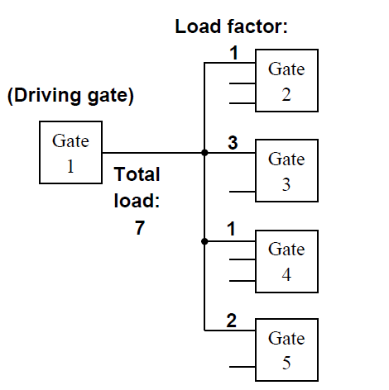
Load factor
Each gate has a specific load factor at the input
The driving gate “sees” a load factor equal to the sum of all the load factors at its output
Higher L implies higher delay
Smaller L implies smaller delay

Slide 16
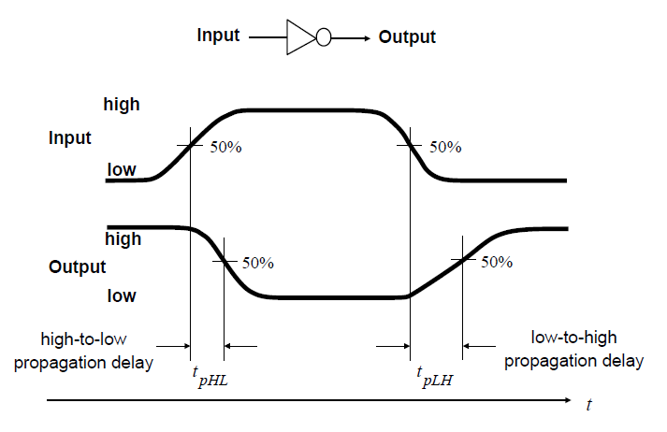
Propagation time
Propagation time is the time required for the output to reach 50% of its final level when the input changes to 50% of its final level.
tpHL = delay for output changing from high to low
tpLH = delay for output changing from low to high

Slide 17
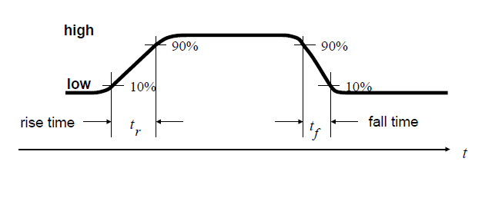
Raise and fall time
The rise time is the time taken by a signal to change from a specified low value to a specified high value. Typically, 10% and 90% of the step height
The fall time is the time taken by a signal to change from a specified high value to a specified low value. Typically, 90% and 10% of the step height

Slide 18
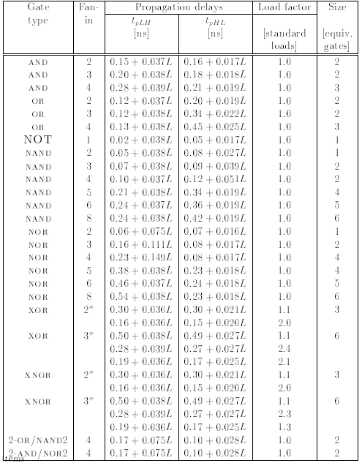
Ex: Characteristics of a family of CMOS gates

Slide 19
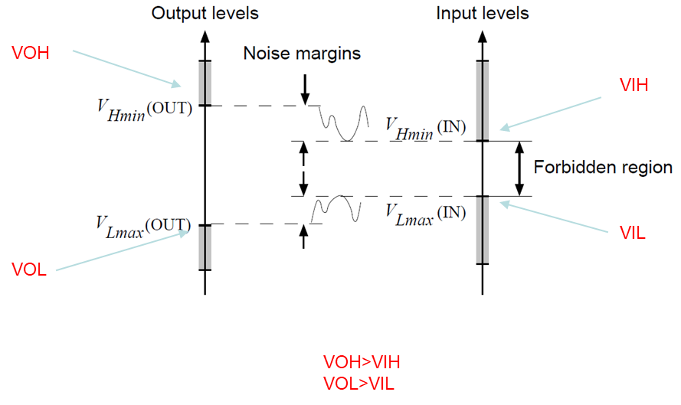
Noise margins
Levels at output of one gate must be sufficient to drive the next gate.
How much noise can a gate input see before it does not recognize the input?
The noise margin is the voltage difference between output of one gate and input of next. The noise must exceed the margin to make the second gate produce wrong output

Slide 20
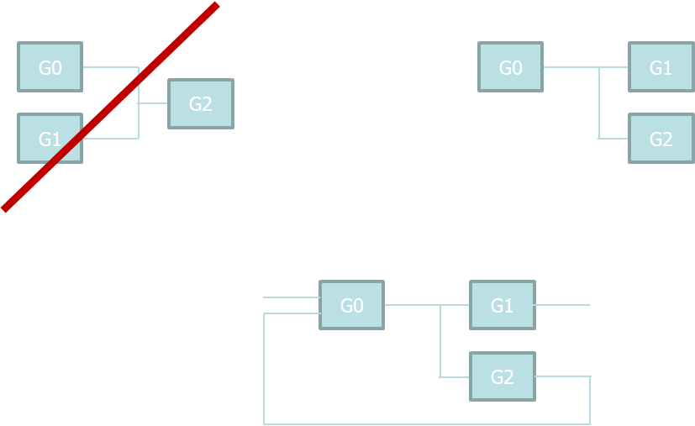
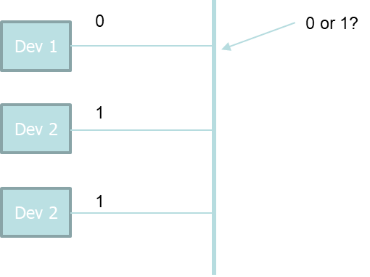
Connection of systems
3
Transmission gates or tri-state buffers can be used to connect more devices to the same wire or bus

Slide 21
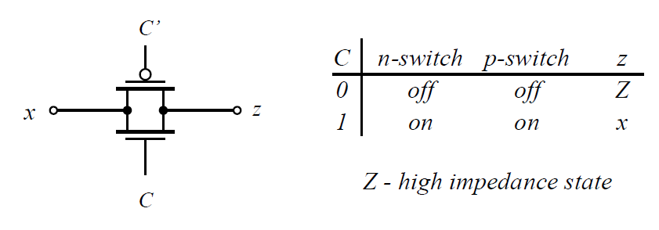
CMOS circuits: Transmission gate
Transmission gate: a gate composed by a pair of complementary transistors

Slide 22
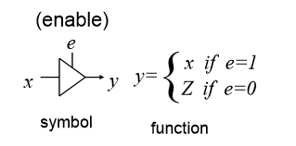
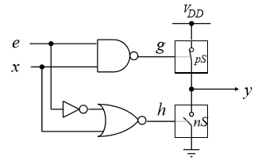
CMOS circuits: Tri-state buffer
If e=0 the two switches pS and nS are open and a high impedance (Z) is provided at the output
Unlike transmission gates, tri-state buffers restore the output signal.

